Slide 1
Report 04/16/2020
P. Hacker

Slide 2
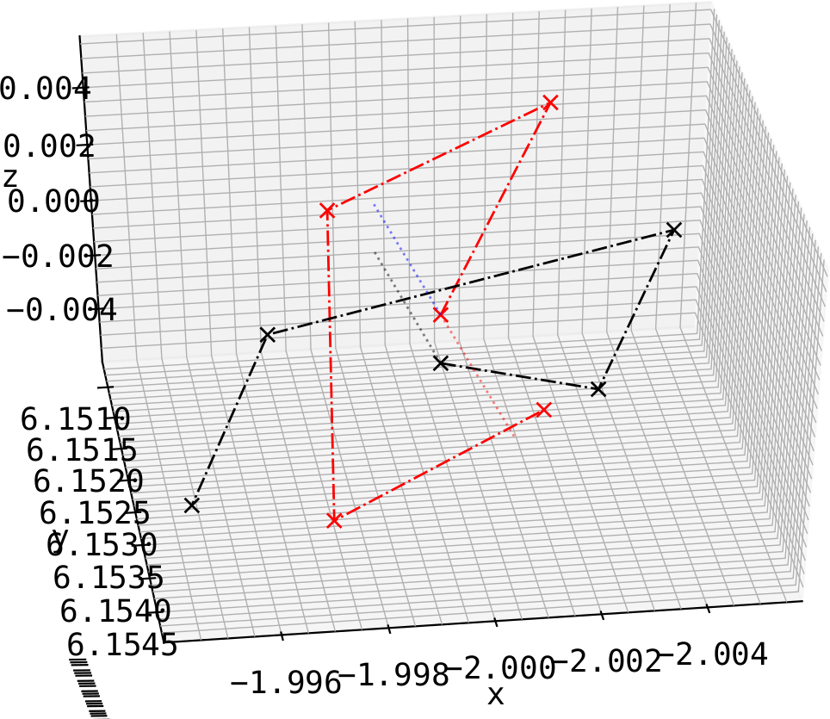
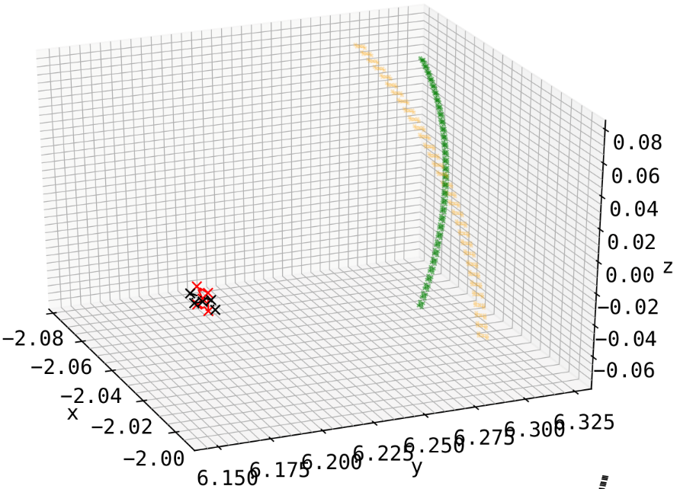
Setup
creating symmetric, upright, rectangular aperture at location of old one (HBCm) with plane normal exactly pointing at (0.0, 0.0, 0.0)
detector array equidistant to aperture and to each other behind pinhole and in-line with plane normal
detector plane normal has no angle with pointing vector between aperture and center
artificial
HBCm
HBCm
apt.
artificial

Slide 3
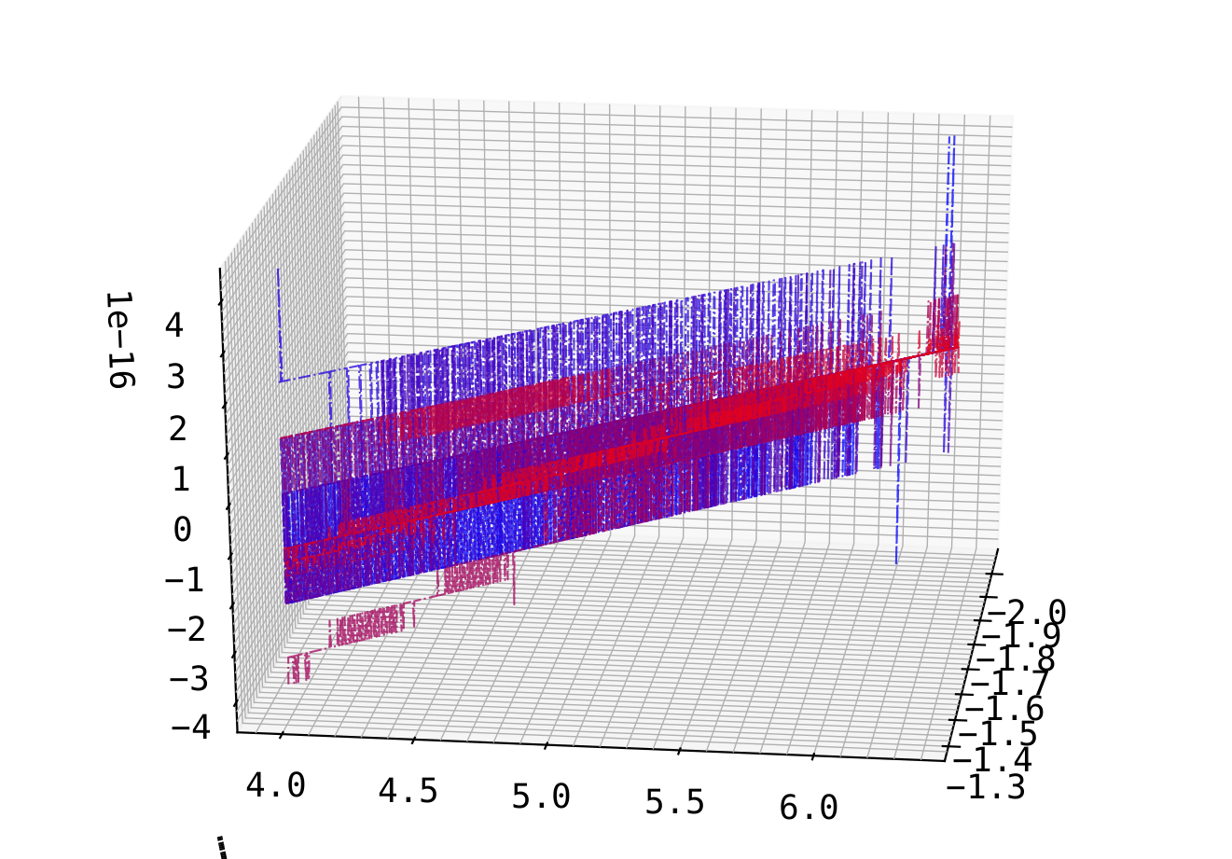
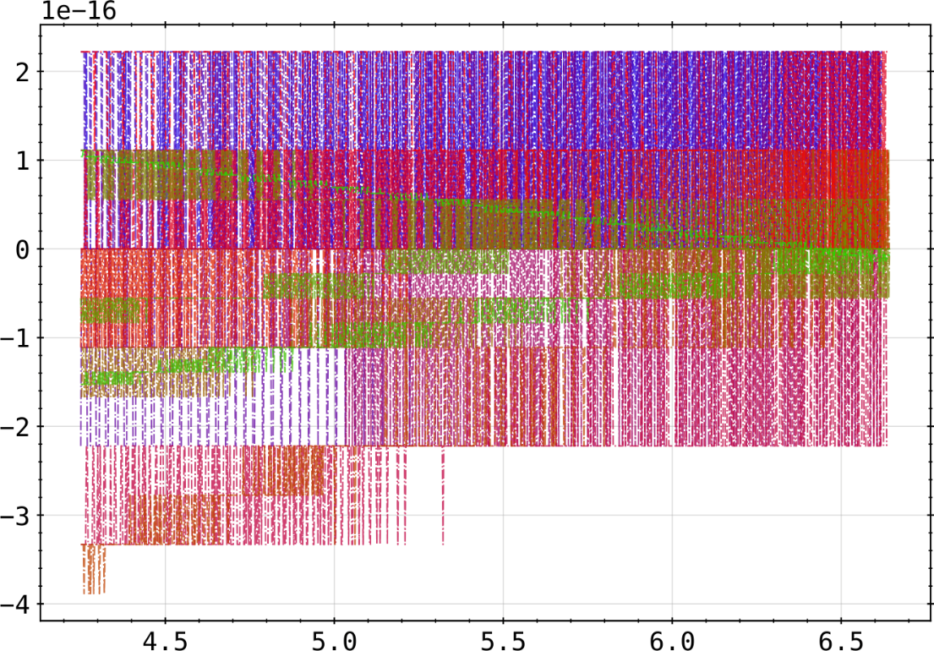
Setup
Lines of sight from this configuration are symmetric (top-bottom) down to the numerical accuracy of a 53 bit encoded double precision float
sum of opposing channels (0-31, 1-30 ,…) in (x,y,z)-space
sum of channels (0-31, 1-30 ,…) in (r,z)-space

Slide 4
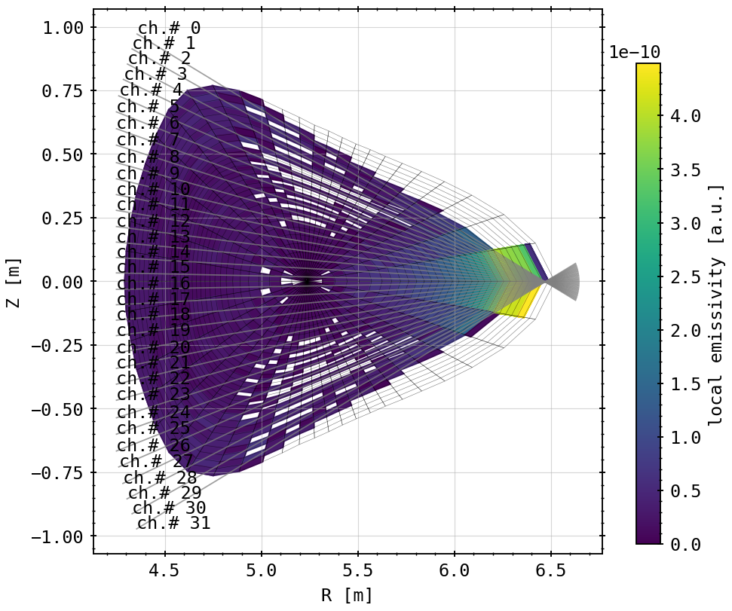
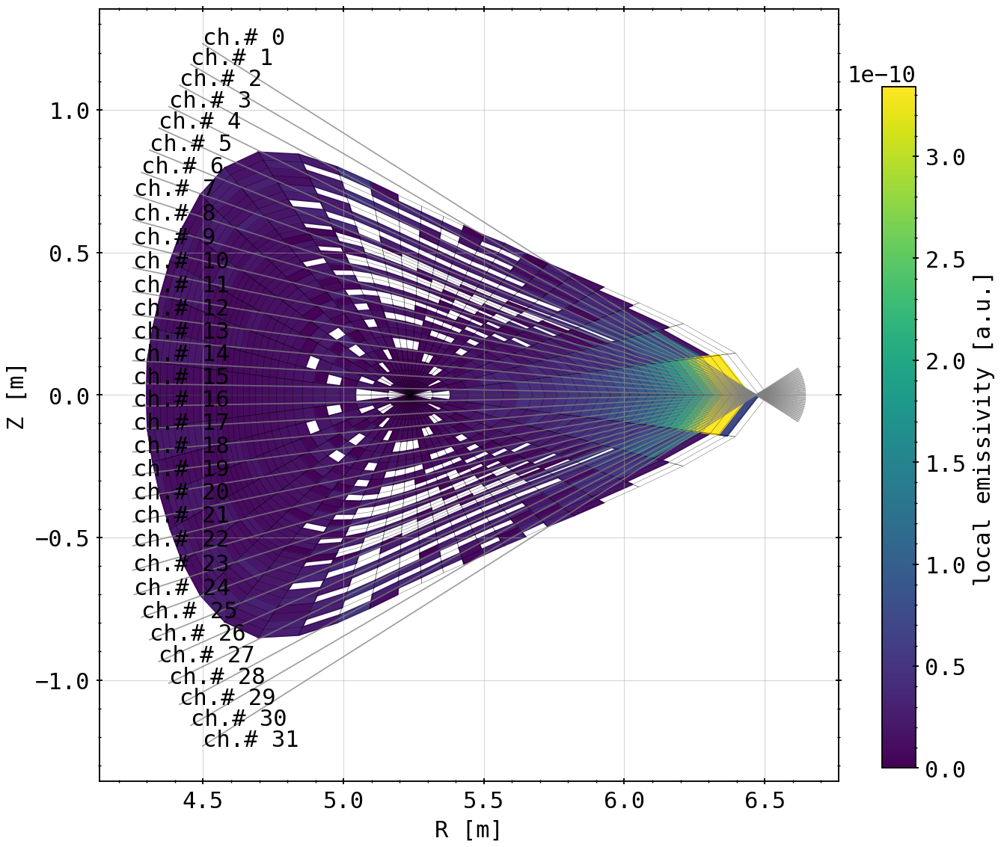
Emissivity on Fluxsurface Cells
almost entirely symmetric emissivity distribution on fluxsurfaces, except artifact in front of aperture
slightly wider opening angle on line of sight-fan

Slide 5
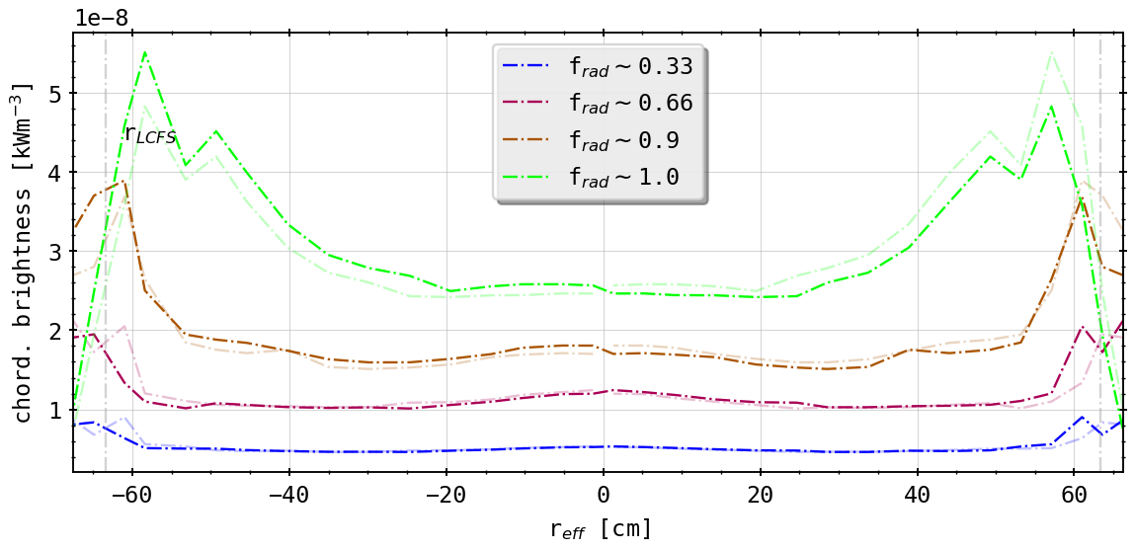
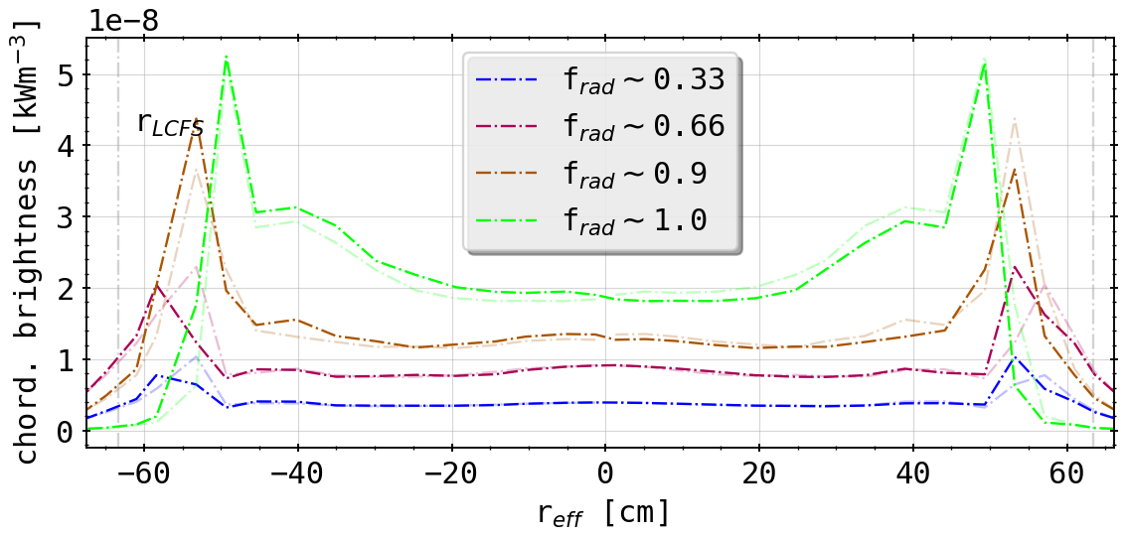
Forward Integral: Standard Case vs. Artificial Array
(forward integration of STRAHL simulations)
(forward integration of STRAHL simulations of artificial, fully symmetric horizontal camera array)
still not entirely symmetric, deviance in fluxsurface geometry? (pinhole is located not exactly at 108 degrees, but rather 107.9)
geometrically very different to ‘standard’ case
more peaked towards edge
far inside the LCFS even for low radiation fraction cases

Slide 6
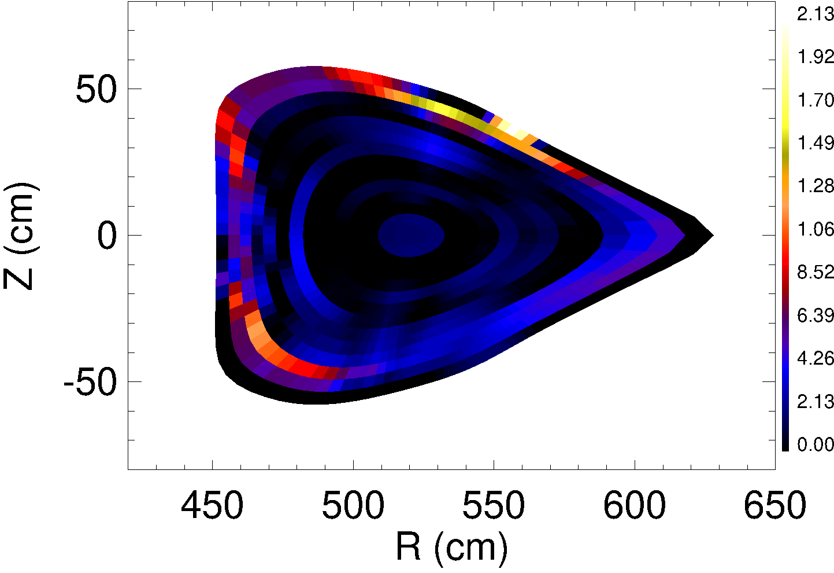
2D Tomography: First Results
geometry files are now being read correctly
anisotropy factors set to 1.5 for divertor (?) or island and 0.8 for core-like regions
t = 3.421s <-> frad=100%

Slide 7
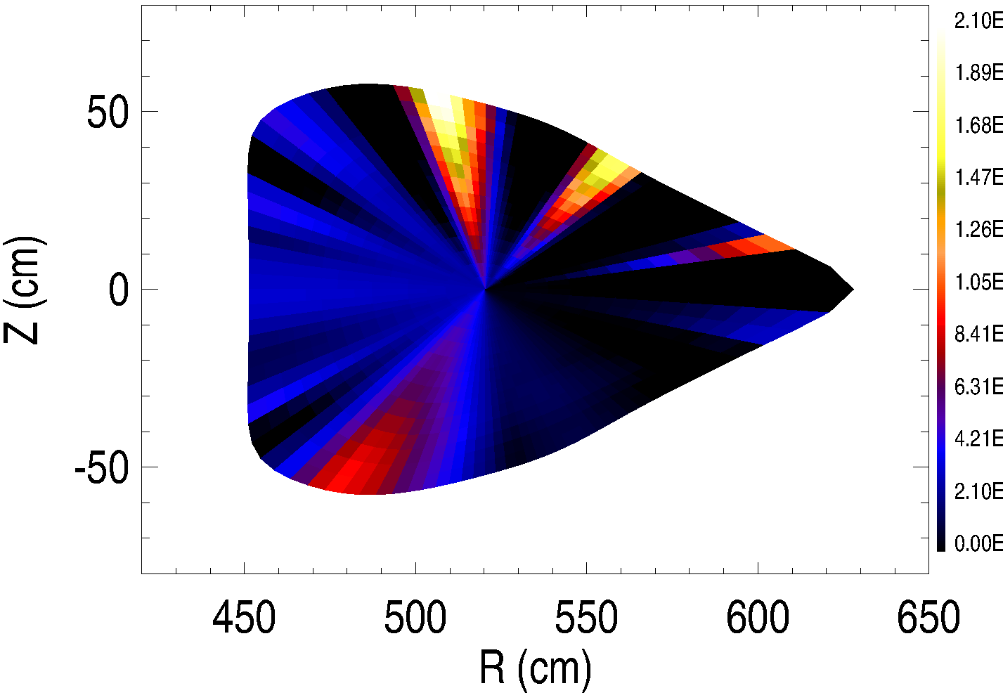
2D Tomography: First Results
anisotropy factors set to 1.0 and 1.0
again: t = 3.421s (frad=100%)

Slide 8
Agenda
Not in order:
start to finish RSI paper (for internal reviewing)
understand anisotropy factor, hence structure of tomogram
create and feed phantom radiation profiles to inversion method using that knowledge

Slide 10
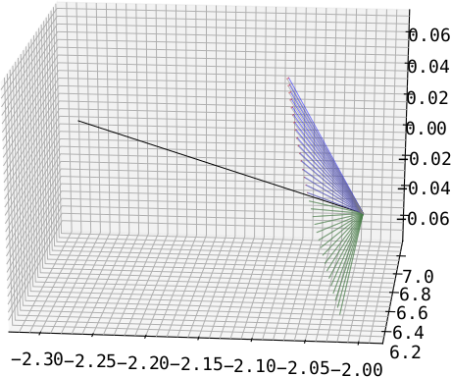
1.: ‘Fix’ Bolometer Planar Error
guided by lower half of detector array (green)
observe difference (red) between opposite channel (e.g. CH#0 <-> CH#31) through rotating around aperture normal by 180° and measuring angle
transforming second channel through rotating it by angle from before (blue)
only really easy for HBCm, because central aperture axis alignment; VBC cameras not possible
aperture
‘fixed’
HBCm
guide

Slide 11
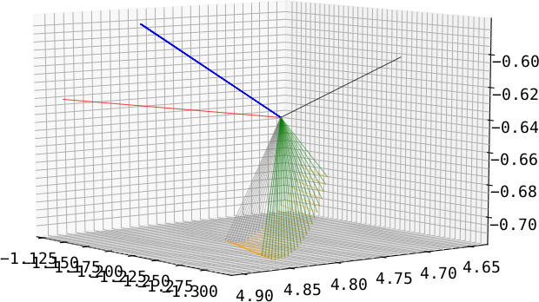
2.: Toroidal Transformation to Axis Plane
guide is normal of plane constructed by detector fan (blue)
transforming all channels so that normal points in/at toroidal direction (red)
transformation for each channel individual (see previous argument (1.)) (orange)
done for all cameras individually
old normal(s)
aperture normal
target normal
old fan
new fan
VBCr

Slide 12
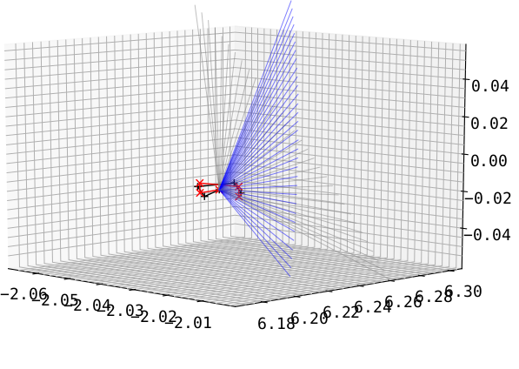
3.: Tilting the Detector Fan Up/Down
take results of (2.) and tilt the entire fan including the aperture poloidally (grey to blue and black to red)
HBCm
(results for (2.) with aperture change included)

Slide 13
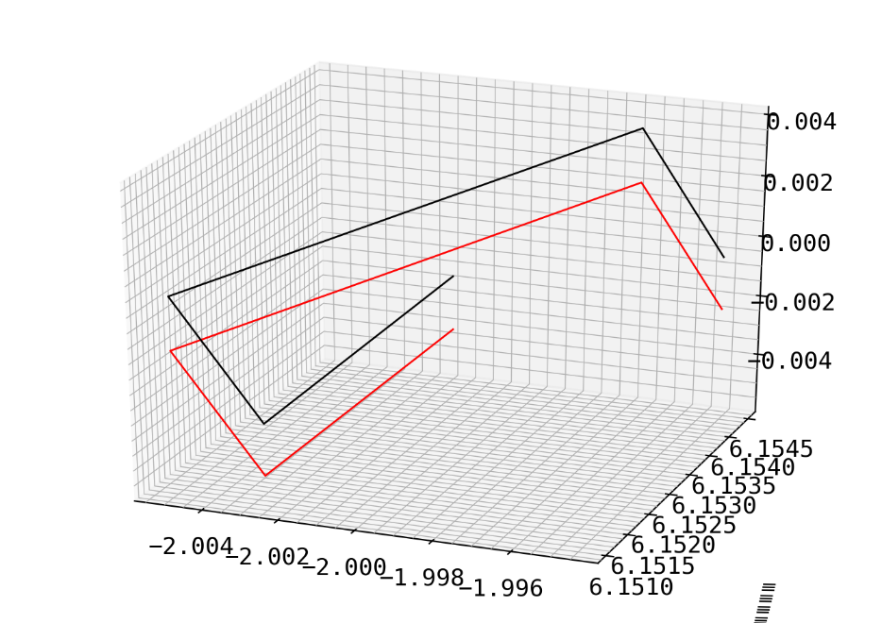
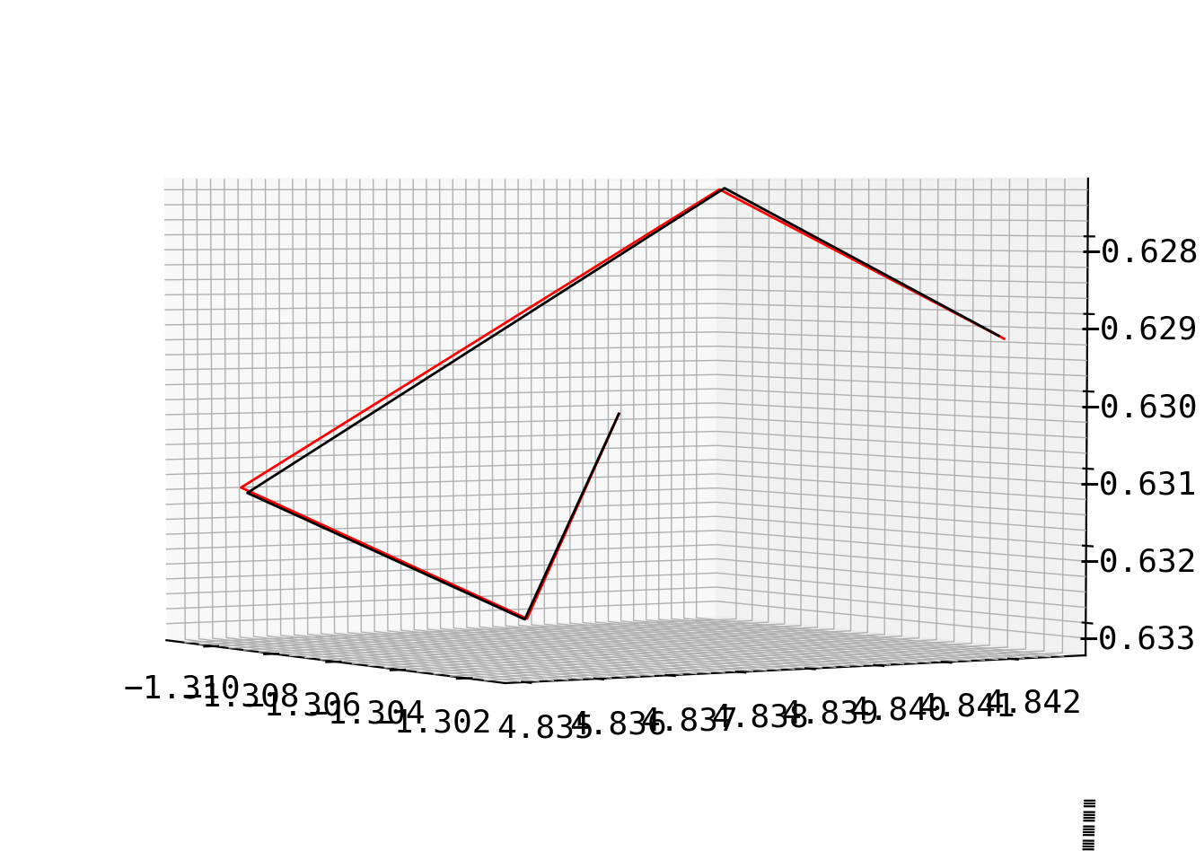
Centering of Aperture and Random Error
center the aperture center (black) on z = 0 axis and shift entire array accordingly to red
introduce measurement error to aperture and detector positions of maximum 0.1mm (randomly distributed) and see resulting tilt in camera fan
degree of tilt 0.5° - 2.0°, but omnidirectional
aperture
centered
perturbed
aperture

